Slide 1
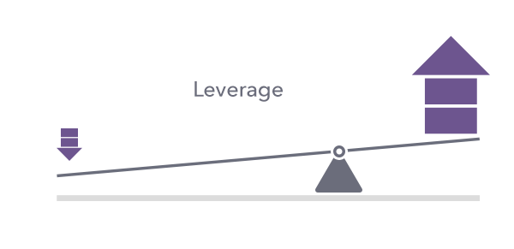

Slide 2
Leverage
Leverage means the employment of assets or funds for which the firm pays a fixed cost or fixed return.
The concept that is used to study the effects of various mix of debt and equity on the shareholder's return and risk in the capital structure of a firm is called leverage.

Slide 3
Types of Leverage
Operating Leverage
Financial Leverage
Combined Leverage

Slide 4
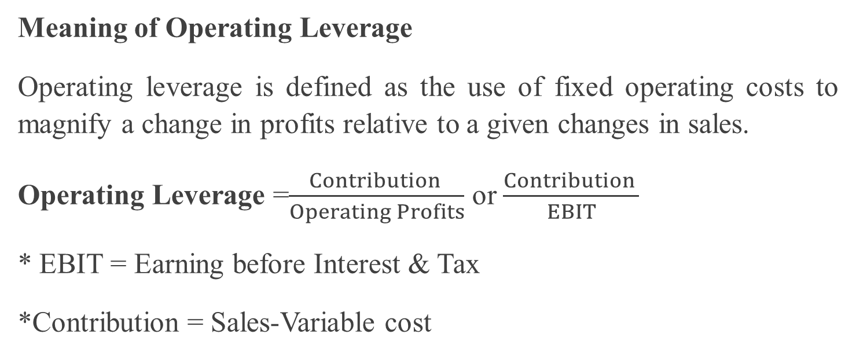
Meaning of Operating Leverage
Operating leverage is defined as the use of fixed operating costs to magnify a change in profits relative to a given changes in sales.
Operating Leverage =$\frac{Contribution }{Operating Profits}$ or $\frac{Contribution }{EBIT}$
* EBIT = Earning before Interest & Tax
*Contribution = Sales-Variable cost

Slide 5
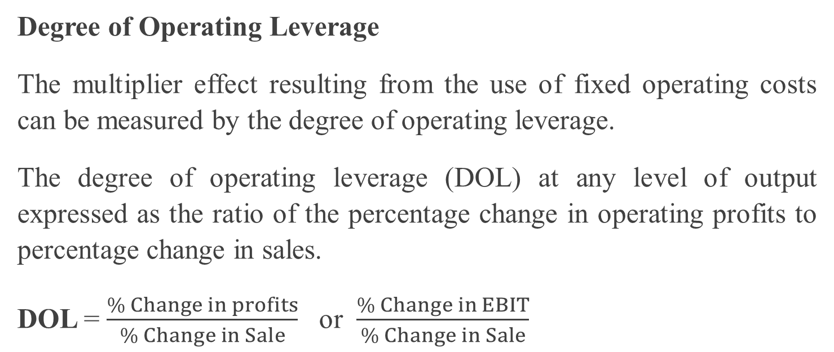
Degree of Operating Leverage
The multiplier effect resulting from the use of fixed operating costs can be measured by the degree of operating leverage.
The degree of operating leverage (DOL) at any level of output expressed as the ratio of the percentage change in operating profits to percentage change in sales.
DOL = $\frac{\% Change in profits}{\% Change in Sale}$ or $\frac{\% Change in EBIT}{\% Change in Sale}$

Slide 6
Characteristics of Operating Leverage
It is related to the assets side of balance sheet.
It is directly related to break-even point.
It is related to selling price and variable costs.
It involves business risk.

